Slide 1


Presentation on Historica AR/VR Powered Immersive Historical Learning Experience
Guided By: Presented By:
Prof. Monika Choudhary Atharv Sharma (0827IT233D02)
Khushi Agrawal (0827IT221076)
Abhishek Rathore (0827IT233D01)
Jatin Rao (0827IT233D03)

Slide 2
Contents
Introduction
1.1 Overview
1.2 Purpose
Literature Review
Problem Statement
Proposed Solution
Objectives
Block Diagram
Key Features
Social Impact and Applications
REFERENCES

Slide 3
1. Introduction
1.1 Overview
Historica is a web-based platform that provides interactive 3D models of historical sites, showcasing how they appear.
It allows users to explore ancient landmarks in detail with zoom, rotation, and AR integration for an immersive experience.
The platform combines historical accuracy with digital technology, making history more engaging and accessible.
Designed for students, researchers, educators, and history enthusiasts, it serves as an educational and cultural preservation tool.
1.2 Purpose
Enhance Historical Learning: Provides an interactive way to study history with visual reconstructions, making education more engaging.
Virtual Exploration & Tourism: Enables users to experience historical sites remotely, bridging the gap between travel and digital learning.

Slide 4
2. Literature Review
Sr. No. | Name of Solution/System | Features | Limitations/ Drawbacks
1. | Sketchfab (Cultural Heritage) | Allows users to explore 3D models of historical artifacts and sites | No integrated historical storytelling or AR experience
2. | HistoryView VR | Provides virtual reality tours of historical places | Limited 3D reconstructions
3. | National Geographic AR Experiences | Offers interactive 3D models of ancient structures via mobile devices | Not a full-fledged platform for historical site exploration

Slide 5
3. Problem Statement
Traditional historical learning methods do not provide an immersive, engaging, and easily accessible way to visualize ancient architecture and environments. Many modern solutions rely on VR headsets or specialized software, making them inaccessible to a broader audience.
There is a need for a web-based platform that offers interactive 3D models of historical sites, allowing users to explore these locations as they originally appeared—without requiring additional hardware or applications. The Historica aims to bridge this gap by providing realistic, interactive 3D AR models of ancient landmarks, combined with historical descriptions and insights, making history more engaging, accessible, and educational for students, researchers, and history enthusiasts worldwide.

Slide 6
4. Proposed Solution
The Historica is a web-based platform that provides interactive 3D models of historical sites, allowing users to visualize how these landmarks appeared in ancient times. Unlike existing solutions that require VR headsets or mobile apps, this website is accessible directly from a browser, making history engaging, immersive, and widely available.
Key Features:
High-Quality 3D Reconstructions – Users can explore detailed, historically accurate models with zoom, rotation, and annotations.
Web-Based AR Integration – Supports browser-based AR without extra applications.
Informative Historical Context – Clickable annotations provide historical facts and architectural details.
Accessibility & Preservation – No special hardware required, ensuring global reach and cultural heritage preservation.

Slide 7
5. Objectives
Develop high-quality 3D models of historical sites to showcase their original appearance.
Implement web-based Augmented Reality (AR) for immersive exploration without extra software.
Provide detailed historical descriptions and annotations to enhance learning.
Ensure accessibility on all web browsers without requiring VR headsets.
Digitally preserve cultural heritage for future generations.

Slide 8
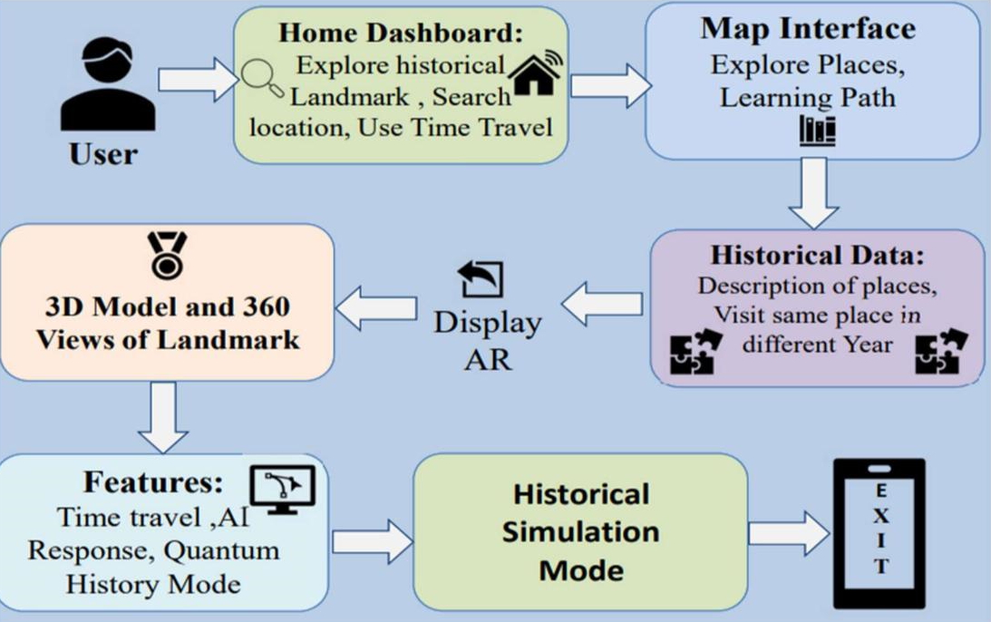
6. Block Diagram
Fig 6.1 Work Flow Diagram

Slide 9
7. Key Features
Time Travel in AR: Explore any historical event 3D
Generative AI Scene Reconstructions: Realistically recreate historical scenes with AI based
Character and Object Interaction: Users can interact (Chat with Ai Avtar) with historical figures and objects to gain detailed insights.
Historical Simulation Mode: Simulate alternate histories and explore "WhatIf" scenarios using AI.
Quantum History Mode: Explore alternate historical realities and parallel timelines.
AI-Reconstructed Lost Worlds: Experience extinct ecosystems and species in prehistoric times.

Slide 10
8. Social Impact & Application
Educational Tool: Enhances classroom learning with interactive 3D models and detailed historical narratives.
Virtual Tourism: Enables remote exploration of ancient
sites, providing immersive visualizations for travelers.
Research & Preservation: Serves as a digital archive for historians and archaeologists, preserving cultural heritage.
Public Engagement: Offers an accessible platform for history enthusiasts to explore and learn about ancient civilizations.

Slide 11
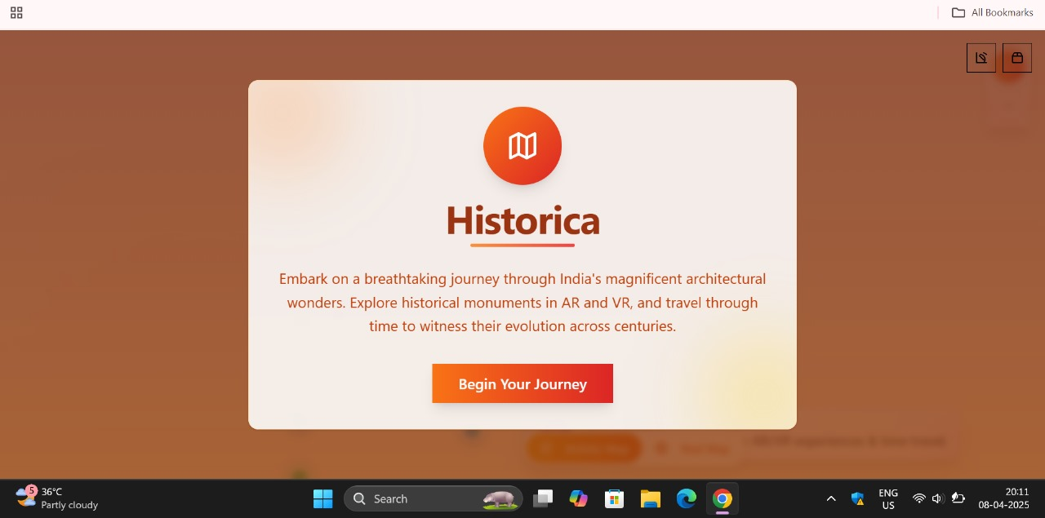
SnapShot from Historica

Slide 12
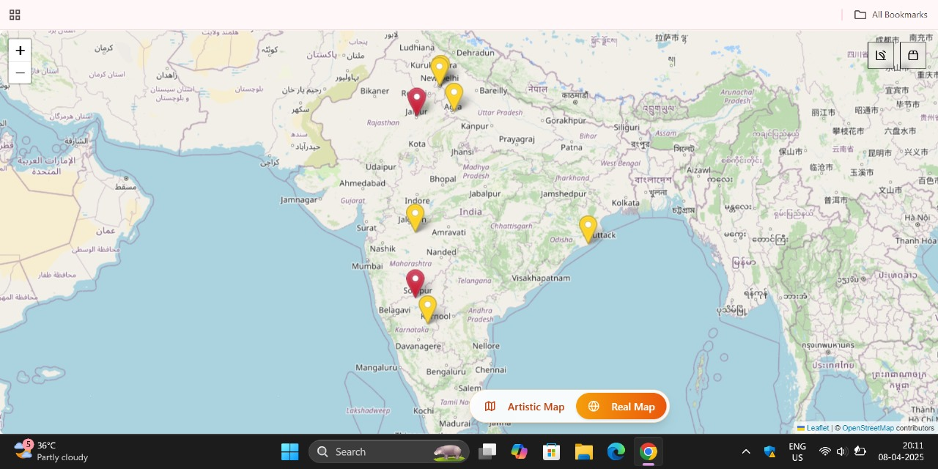

Slide 13
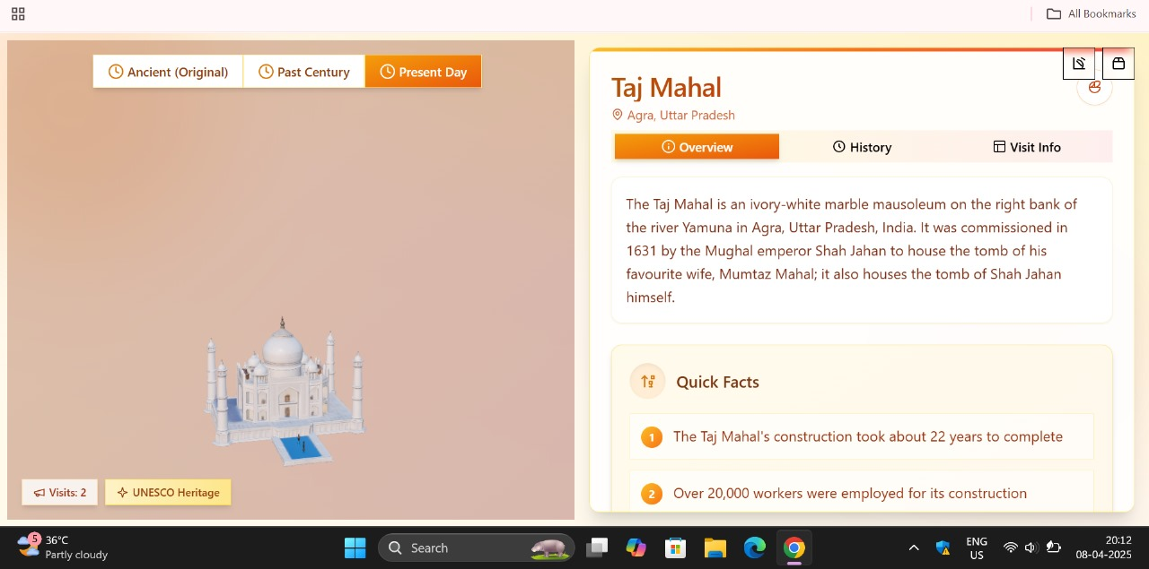

Slide 14
REFERENCES
WebAR and 3D Visualization Technologies: Utilizes Three.js (threejs.org), A-Frame (aframe.io), and Model Viewer (modelviewer.dev) for rendering interactive 3D models and AR experiences in web browsers.
Archaeological & Historical Research Sources: Based on UNESCO’s cultural heritage data (whc.unesco.org), academic research papers, and museum archives to ensure accurate reconstructions of historical sites.
CyArk (www.cyark.org)

Slide 15
GitHub Link
https://github.com/Atharv-082004/Historica

Slide 16
Thank You
Queries ?

